Slide 1

AKS Office Hours
Kendall Roden
Cloud Native Technical Specialist
Kendal Roden
Cloud Native Technical Specialist
Dave Strebel
Cloud Native Technical Specialist

Slide 2

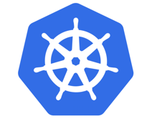


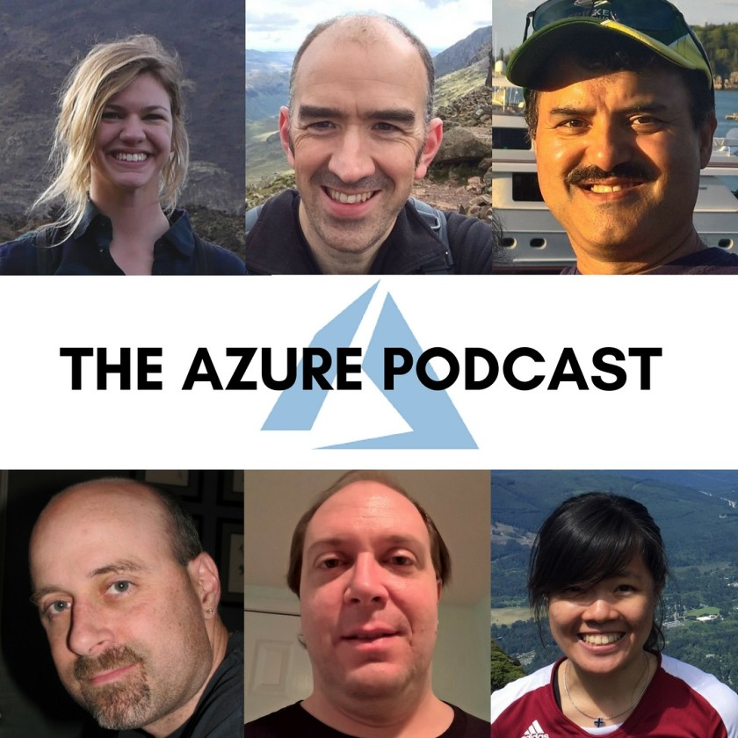


Who are we?
@kendallroden​
@dave_strebel​

Slide 3
Why AKS Office Hours?
Provide AKS customers with updates pertaining to AKS and the Cloud Native Ecosystem
Host a short talk and/or demo on Cloud Native technologies related to Kubernetes and AKS
Collect feedback from customers on issues, blockers, use cases, and questions related to AKS

Slide 4
What to expect
Call agenda
10 minutes: Welcome, followed by AKS and ecosystem updates
30-40 minutes: BYO Private Zone for Private Clusters
10 minutes: “Ask us anything” and customer feedback discussion
Keep in mind
Office hours are hosted primarily by the GBB team, with the support of the PG
Recordings and content will be available post-call on GitHub, barring any technical difficulties
Contact us with thoughts, ideas or questions (aksofficehours@microsoft.com)

Slide 5

AKS Updates

Slide 6
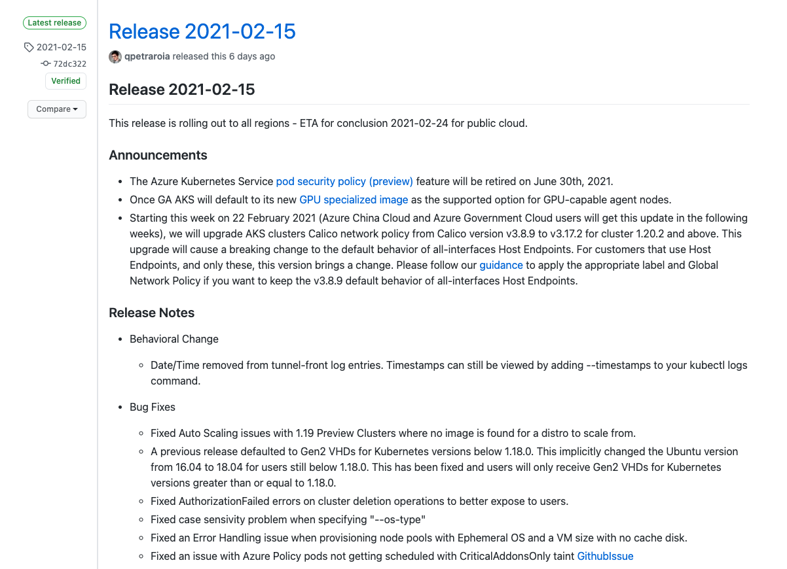
AKS Release Notes
AKS legacy Azure AD integration will be retired on 29 February 2024
Transition to AKS-managed Azure AD before this date!
Notes:
Because Azure Kubernetes Service now uses Managed Azure Active Directory to simplify the Active Directory integration process, we will be retiring the legacy Azure Active Directory Integration on 29 February 2024. Any Azure Kubernetes Service cluster using the legacy Azure Active Directory integration will be unsupported after 29 February 2024. Please transition to using the Managed Azure Active Directory Integration by that date.
Action required
To avoid or minimize disruption to your Azure Kubernetes Service cluster tr
AKS-managed Azure AD integration is designed to simplify the Azure AD integration experience, where users were previously required to create a client app, a server app, and required the Azure AD tenant to grant Directory Read permissions. In the new version, the AKS resource provider manages the client and server apps for you.
ansition to AKS-managed Azure AD before 29 February 2024.

Slide 7
Ecosystem Updates

Slide 8
Open Source and Ecosystem call outs
General Availability: Azure Red Hat OpenShift support for OpenShift 4.6
Learn more
Terraform blog updates:
Terraform Mono Repo vs. Multi Repo: The Great Debate
Announcing version 2.0 of the Kubernetes and Helm Providers for HashiCorp Terraform
KubeWeekly:
What books to read to learn more about K8s
K8s deployment anti-patterns
Configure Namespaces for Multi-Tenancy
KubeCon + CloudNativeCon Virtual //Europe (5/4-5/7)
CNCF online programs
EDGE Computing World //Europe (3/9-3/11)
CNCFVIP for 20% off registration
Notes:
Version 2.0 of the Kubernetes and Helm providers includes a more declarative authentication flow, alignment of resource behaviors and attributes with upstream APIs, normalized wait conditions across several resources, and removes support for Helm v2.

Slide 9
BYO Private Zone Content links found under Resources

